Slide 1
WEB APPLICATION DEVELOPMENT PROJECT
Stefan Dworschak x15037835
Mark Gaskin x16111931
Graham Farrell x15044726

Slide 2
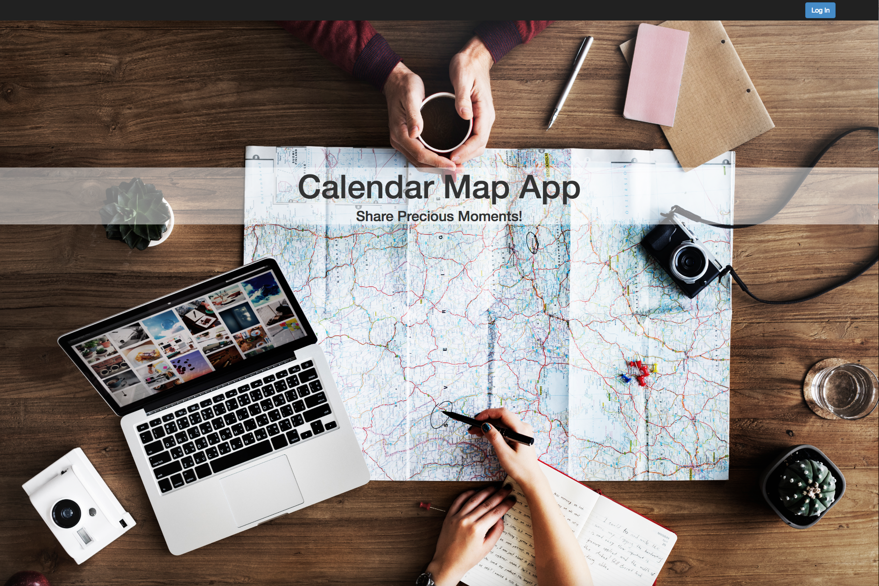
CALENDAR MAP APPLICATION
Created an application for users to login and enter upcoming event details.
Application saves the event details and displays the location and details of the event on a map.
Makes use of technologies learned throughout the module.

Slide 3
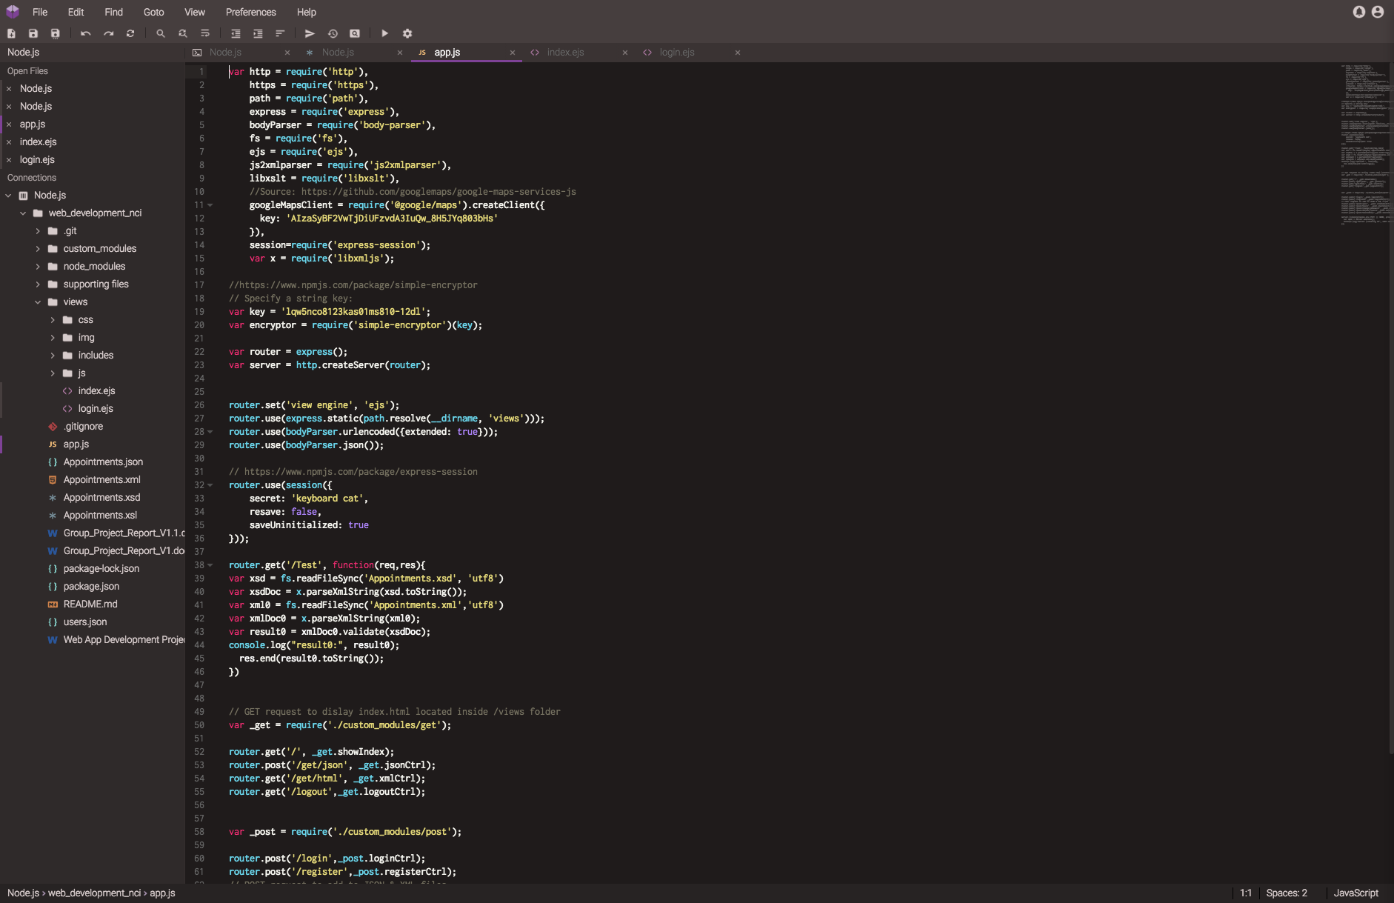
TECHNOLOGIES USED
Google Maps API.
Google Geocode API.
Bootstrap.
XML, XSD & XSL.
JSON.

Slide 4
THANK YOU FOR LISTENING

